Slide 1

Sprocket Central Pty Ltd
Data analytics approach
Govind K , Junior Analyst

Slide 2
Agenda
Introduction
Data Exploration
Model Development
Interpretation

Slide 3
Introduction
Analysis of top 1000 customers to target from given dataset
Outline:
Sprocket is a bicycle company providing high-quality bikes and cycling accessorises.
Using the 3 datasets provided, the analysis was done and the key points will be presented here.

Slide 4
Data Exploration
Key Issues during data exploration
Accuracy: Correct Values
Completeness: Data field with values
Currency: Up to date values
Relevancy: Items with Meta Data
 | Accuracy | Completeness | Consistency | Currency | Relevancy | Validity
Demographic | DOB: Inaccurate | Job Title: Blanks | Gender: Inconsistency | Diseased: Filter
Address |  | Customer ID: Incomplete | States: Inconsistency
Transactions | Profits: Missing | Online Order: Blanks |  |  | Cancelled: Filter Out | List Price: Format

Slide 5
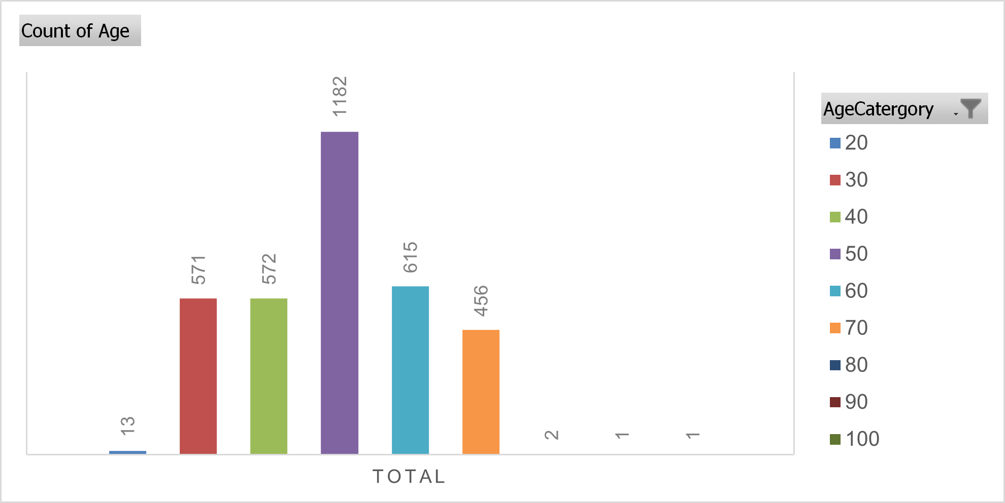
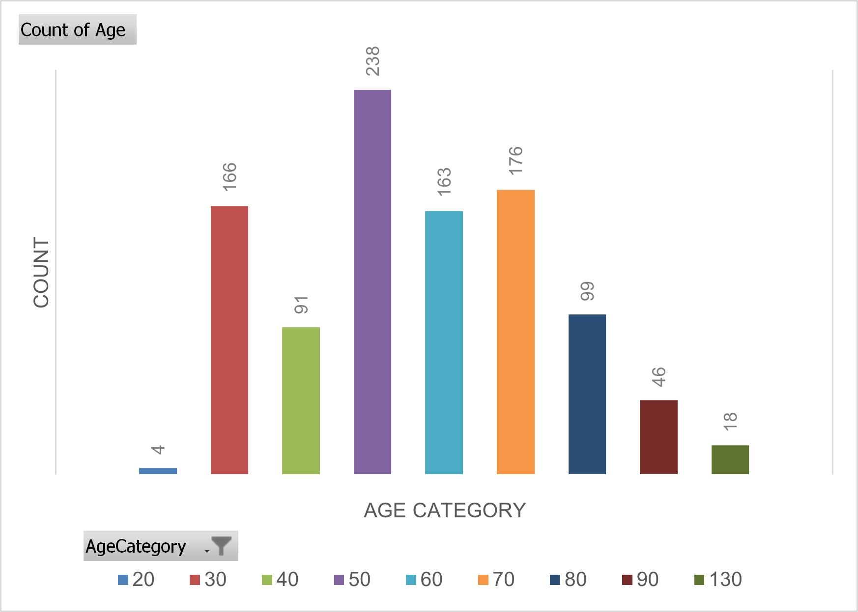
Data Exploration
New and Old Customer Age Distributions
Most customers are between 40-49 in both the lists.
The new age category suggest that there is rise in age group of 20-29.
There is a steep drop of customers in 30-39 category.

Slide 6
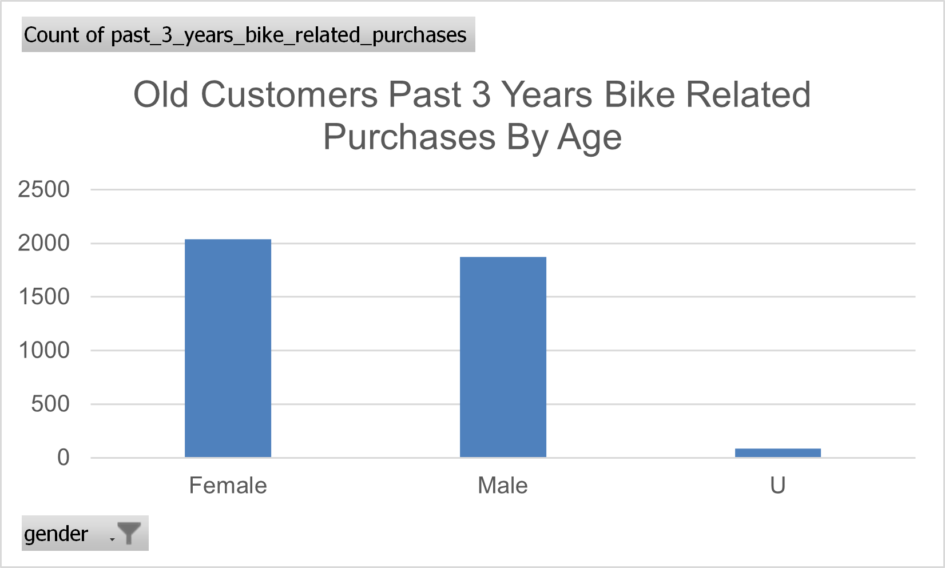
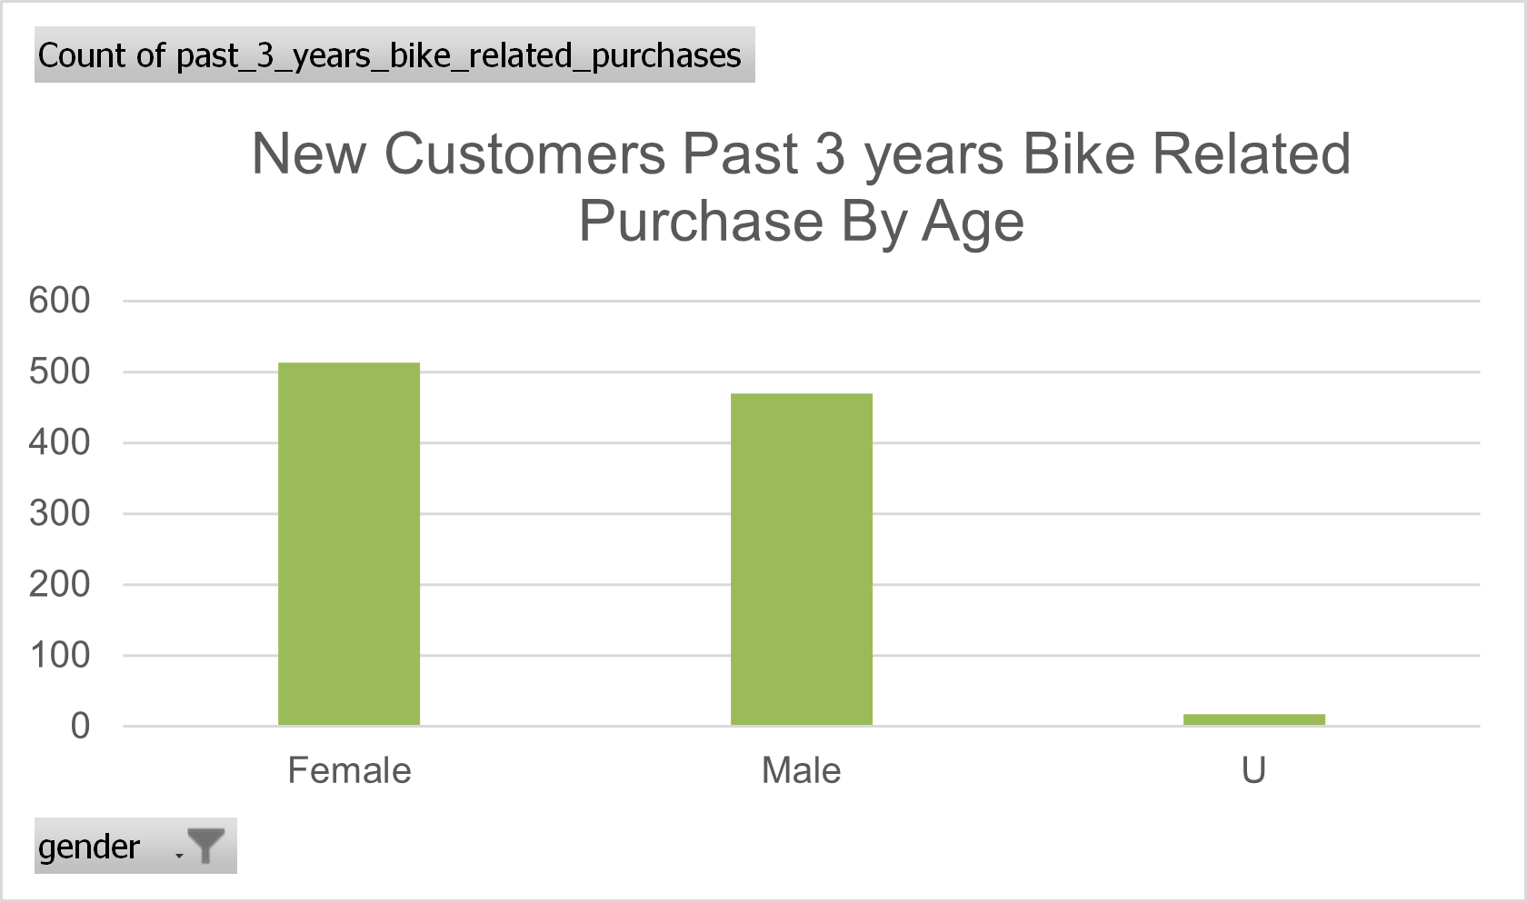
Data Exploration
Bike Related Comparison for the past 3 years by age
Almost 51% of the purchases were made by women.
Numerically, 5% more items were sold to females for both new and old customers

Slide 7
Conclusion
The main goal of the analysis is to highlight the top 1000 customers who will be the most valuable using RMF values which will be continued in MODULE 3.

